Slide 1
Analysis Classes
Ciaran O’Driscoll

Slide 2
Analysis Classes
  Analysis classes are identified from the Use Case Diagrams and supporting documentation.
  Analysis classes lead to identifying Design Classes
  There are three main kinds of analysis classes:
    entity,
    control,
    boundary

Slide 3
What is an Analysis Class?
A class that represents initial data and behavior requirements, and whose software and hardware-oriented details have not been specified
Analysis class diagram – a UML diagram showing analysis classes and their relationships

Slide 4
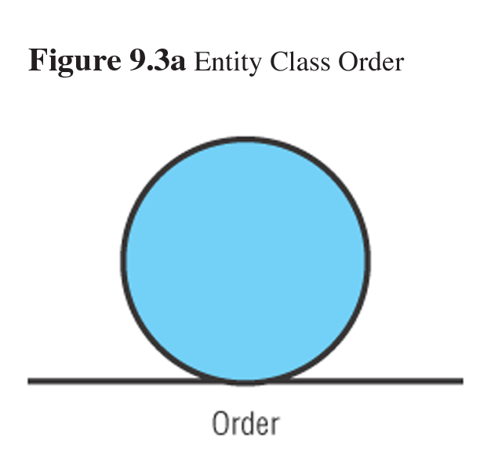
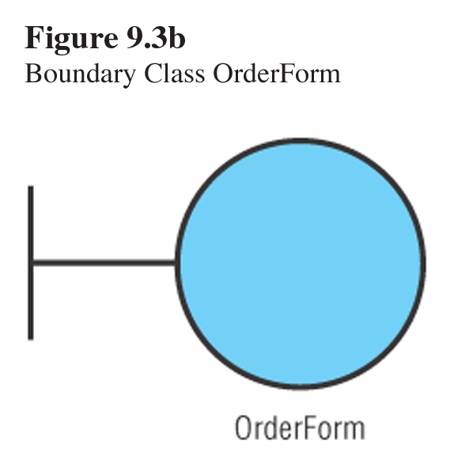
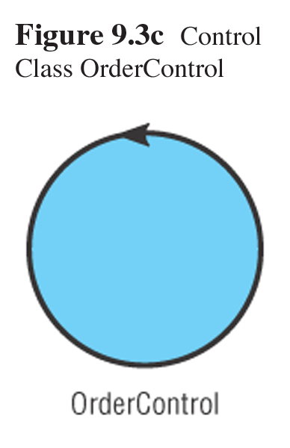
Stereotypes of Analysis Classes
Mostly corresponds to conceptual data model classes
Encapsulates connections between actors and use cases
Mostly performs behaviors associated with inner workings of use cases

